Slide 1


Sri Aurobindo Institute Of Technology, Indore
Learning Point
SUBMITTED BY
PROJECT GUIDE
Shubham Panchal (0873CS193D05)
Iliyas Shaikh (0873CS193D01)
Sachin Pagare (0873CS193D04)
Shubham Chouhan (0873CS181065)
Dr. Praveen Gupta

Slide 2
CONSTANTS
1.Introduction
2.Purpose
3.Problem domain
4.Feasibility survey
5.Technologies
6.Screenshot
7.Future Enhancement
8.Project Link
9.Conclusion
10.Reference

Slide 3
INTRODUCTION
Online Exam System is very much important for any Educational Organizations to prepare their students for any exams by saving the time. It will take check the paper and generate mark sheets as well. It will also help the Organization to test the students and develop their skills. But the disadvantages for this system are, it takes a lot of times when you prepare the exam at the first time for usage. E-Learning exploits interactive technologies and communication systems to improve the learning experience. It has the potential to transform the way we teach and learn across the board. It can raise standards, and widen participation in lifelong learning. It cannot replace teachers and lecturers, but alongside existing methods it can enhance the quality and reach of their teaching, and reduce the time spent on administration. It can enable every learner to achieve his or her potential, and help to build an educational workforce empowered to change.

Slide 4
PURPOSE
E-Learning purpose is important in implementing eLearning as it will help in producing great results if one knows how to use it. The key success of effective eLearning is not only to set goals but to set the right goals. Therefore, it is significant to understand the types of different goals and its unique differences because each goal has its own objectives. Besides, if eLearning is designed and developed without the right goals in mind, it will be a waste of time and money as the problems will need to be addressed again from other perspectives Therefore, in order to set the right goals from the beginning, one should know the different kinds of goals based on the situation and the learning context.

Slide 5
PROBLEM DOMAIN
Despite heavy investments in software, training, and new institutions, e-learning has up to now failed to affect the transformation of teaching and learning at universities that many have hoped for. Why is this? We see two types of problems as main causes for this state of affairs, namely organizational and technical problems. Both types of issues are frequently interrelated. Many organizational problems stem from the fact that a typical university is not a homogeneous, hierarchical organization but rather a loosely coupled system of semi-autonomous entities. Thus, decision-making with respect to the system as a whole can be difficult, and top-down decisions—such as the introduction of e-learning—are likely to face opposition.

Slide 6
FEASIBILITY STUDY
Economical Feasibility -
This is very important aspect to be considered while developing project .We decided the technology based on minimum possible cost factor
All hardware and software cost has to be come by the organization
Overall we have estimated that the benefits the organization is going to receive from the proposed system will surely overcome the initial code and the later on running cost of the system

Slide 7
FEASIBILITY STUDY
Operational Feasibility -
No doubt the proposed system is fully GUI based that is user friendly and all inputs to be taken all self explanatory even to a layman .Besides is a proper training has been decided to let know source the essence of the system to the user so that fell

Slide 8
TECHNOLOGIES
SYSTEM REQUIREMENT
Front End : html, css, Bootstrap
Back End : JDBC, Servlet, JSP
Database : Mysql
System : Pentium IV 2.4 GHz or above.
Hard Disk : 512 Mb minimum.
Monitor : 14’ Colour Monitor.
Mouse : Optical Mouse.
Ram : 512 Mb.

Slide 9
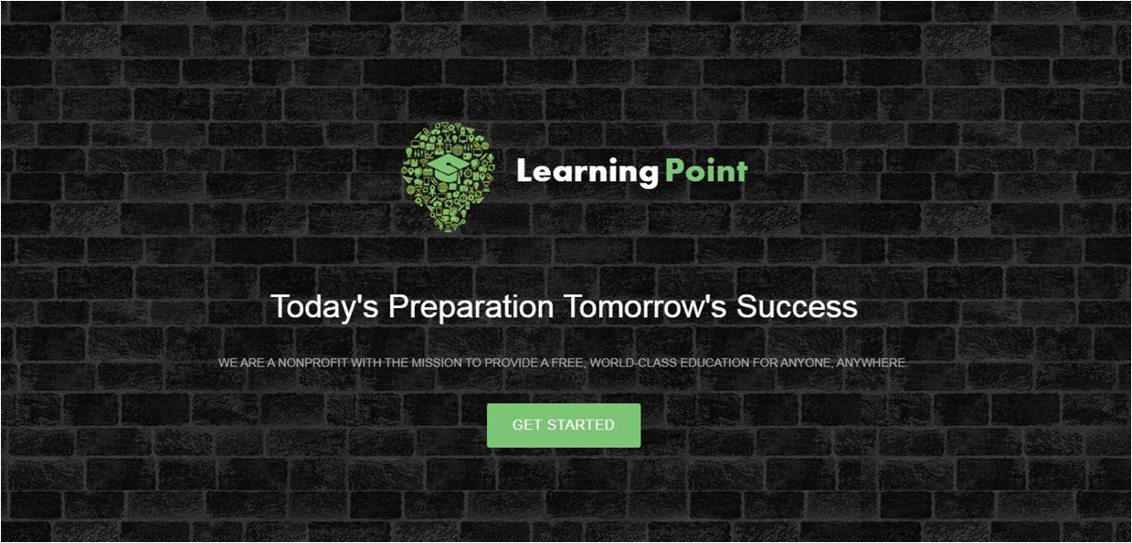
Web Pages -home

Slide 10
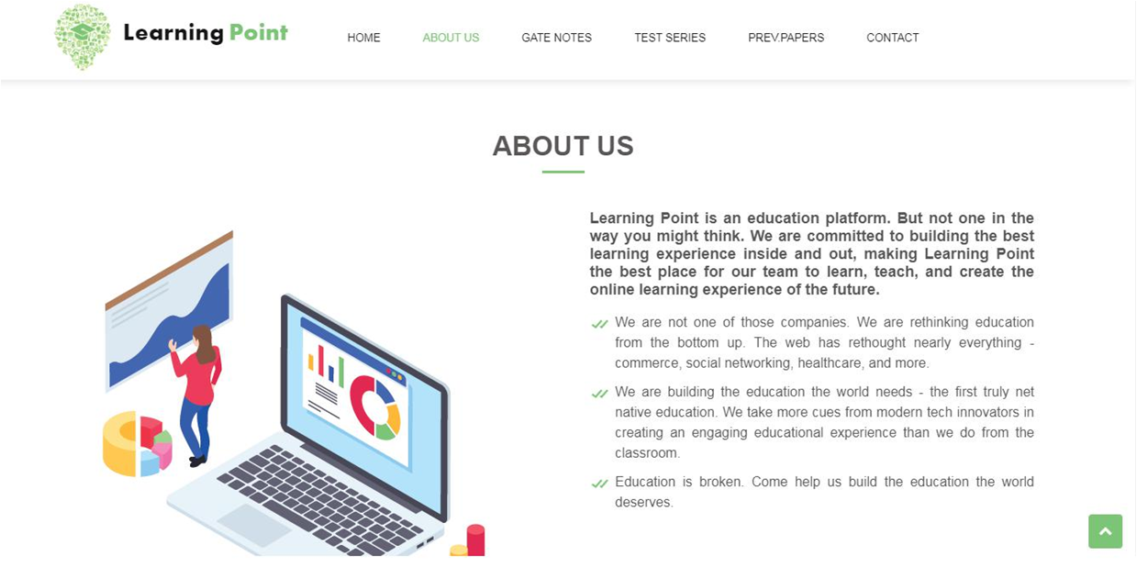
Web Pages - About us

Slide 11
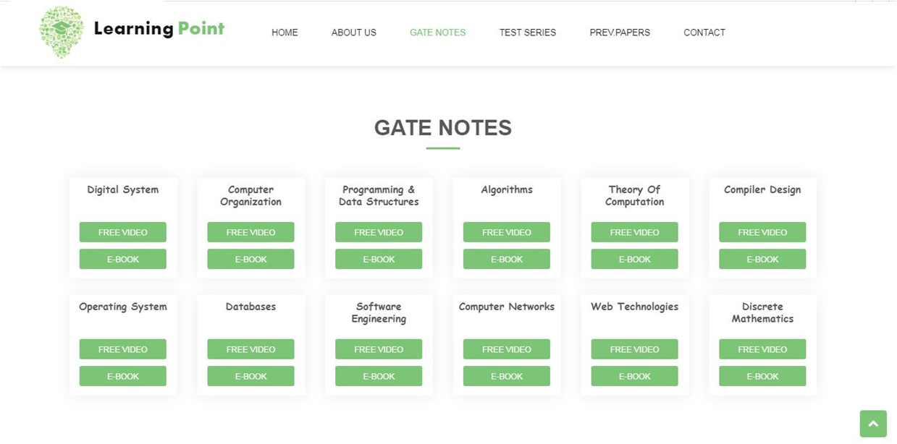
Web Pages - Gate Notes

Slide 12
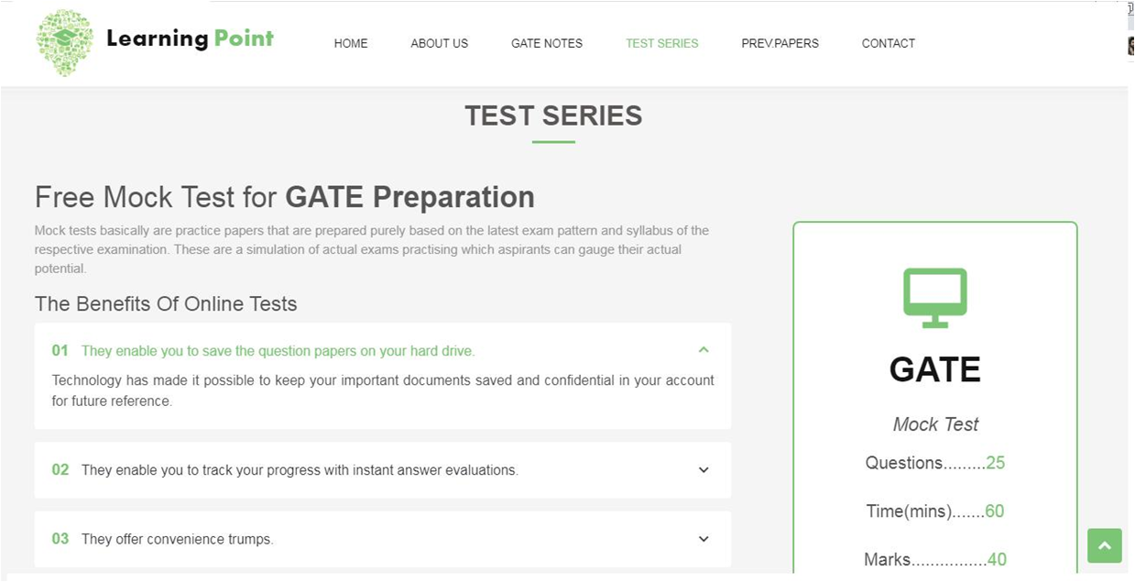
Web Pages - Test Series

Slide 13
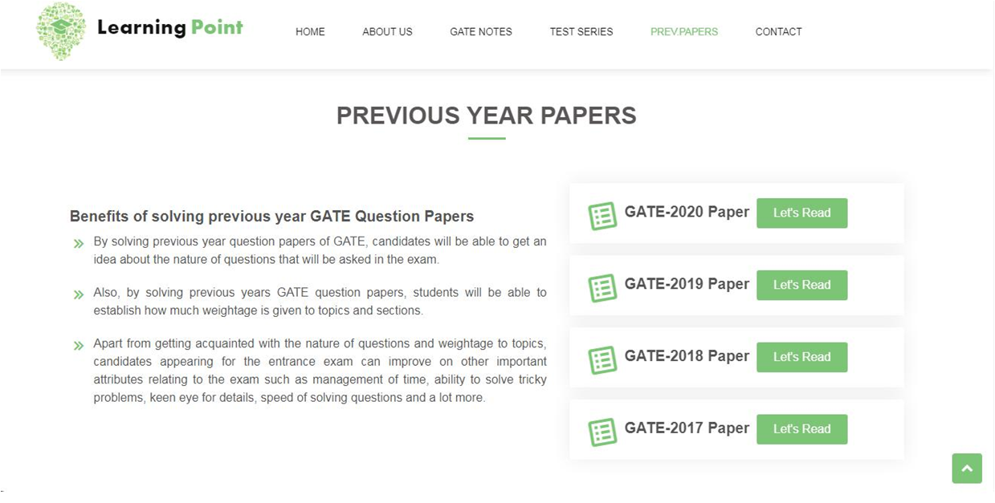
Web Pages - Previous year papers

Slide 14
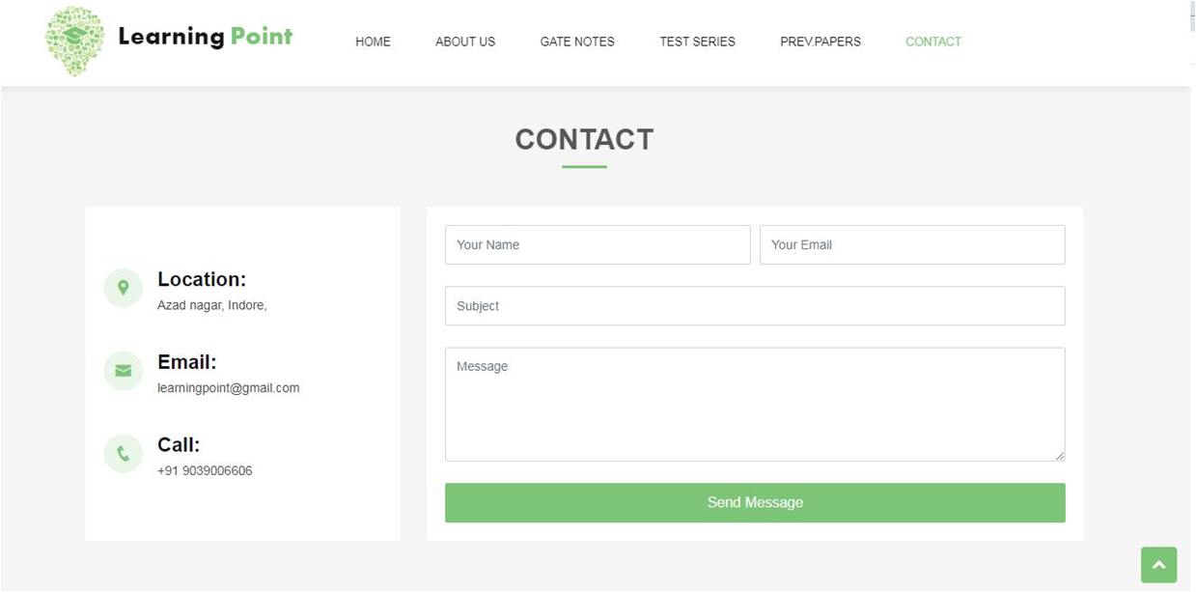
Web Pages - Contact

Slide 15
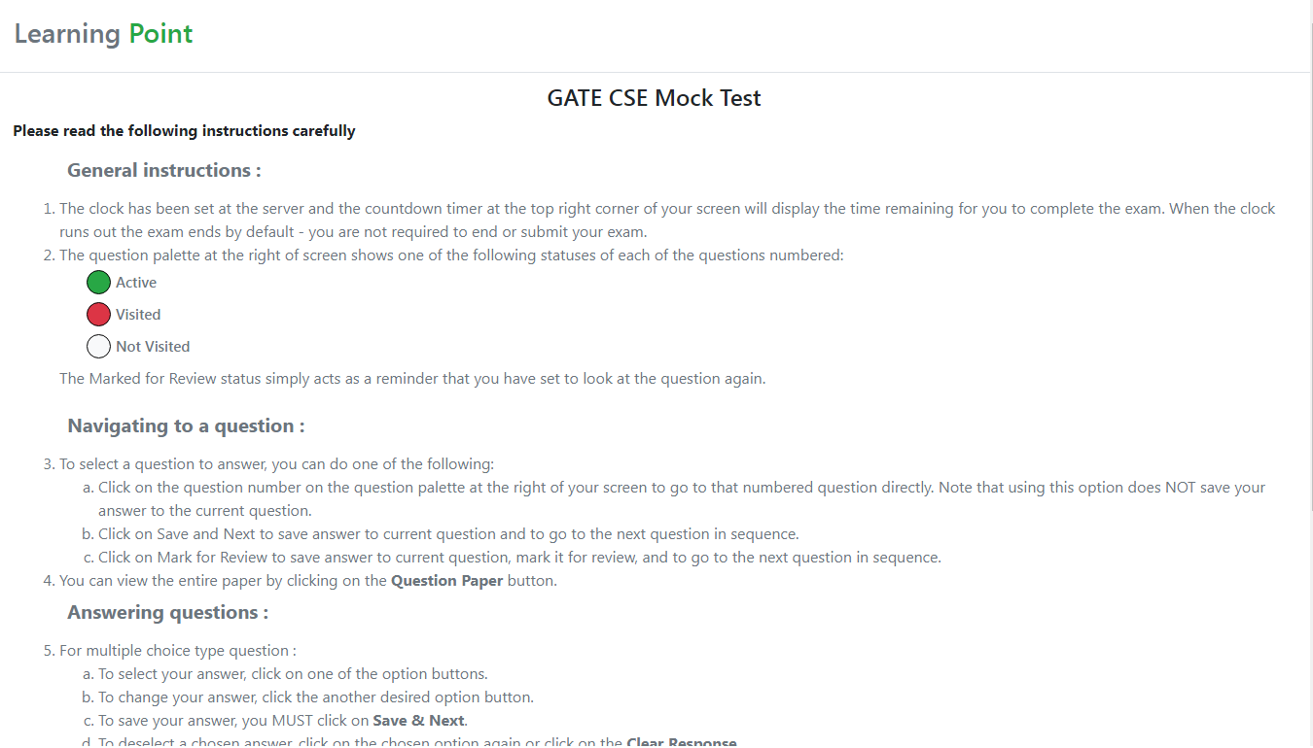
Web Pages - Mock test instruction

Slide 16
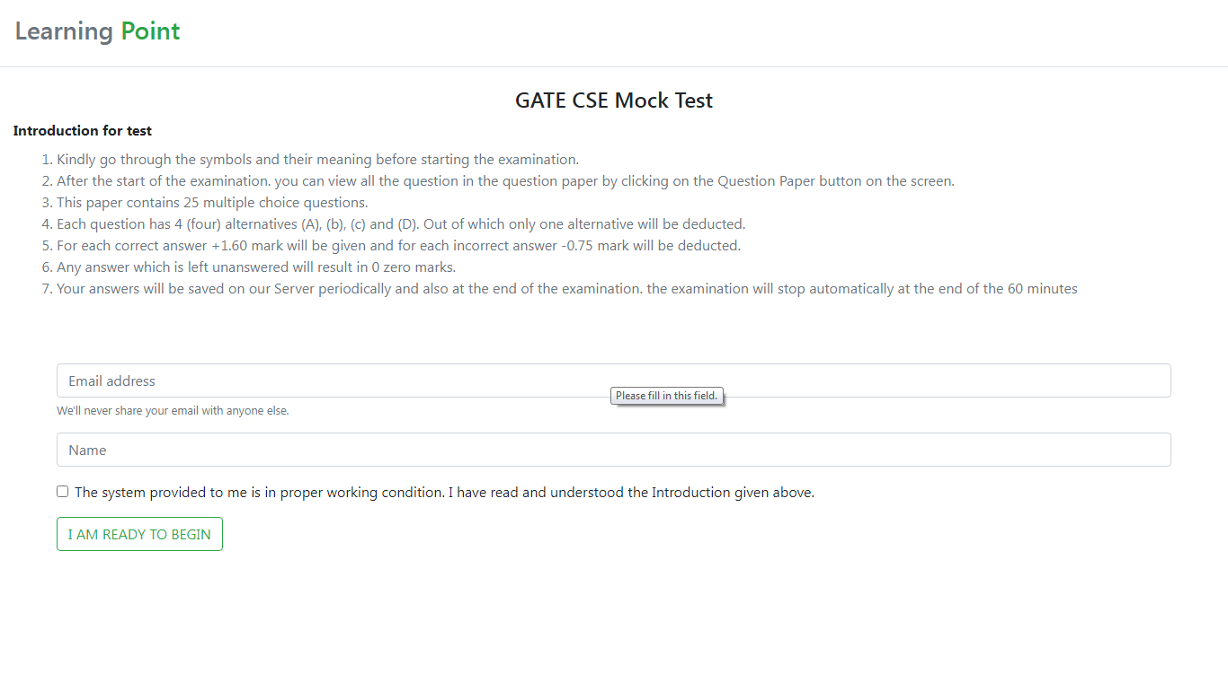
Web Pages - Introduction for test

Slide 17
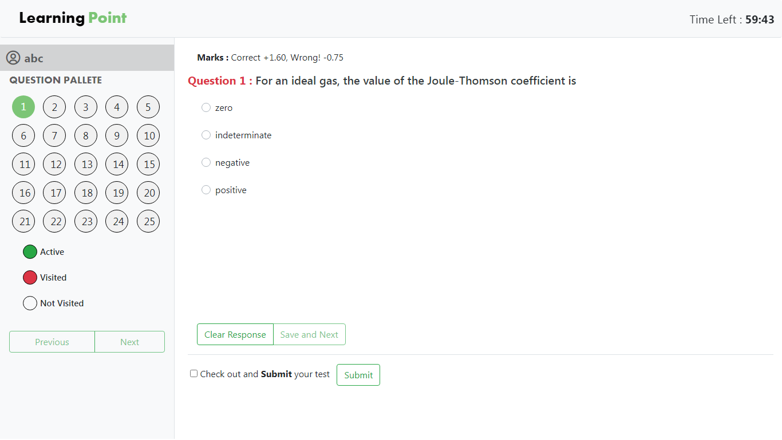
Web Pages - Test Series

Slide 18
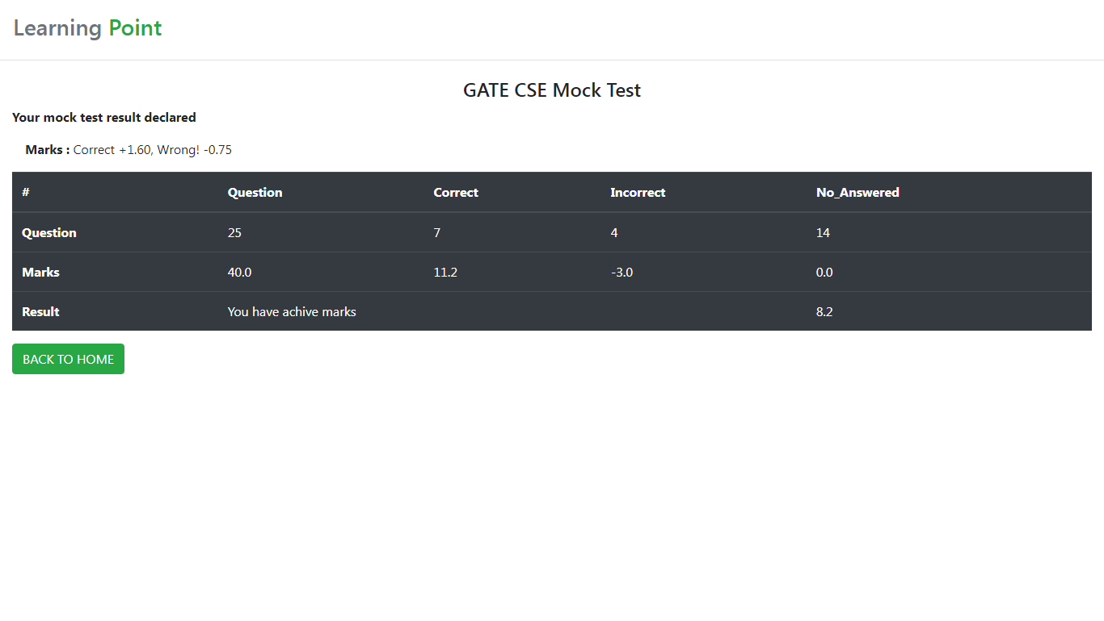
Web Pages - Result

Slide 19
Learning Point - Link
Learning Point

Slide 20
FUTURE ENHANCEMENT
We will use Log4j concept for data log
Database Master - Slave replication
Student login section

Slide 21
CONCLUSION
E-learning is not intended to replace conventional methods and learning in class rooms .Its aim to create an augmented learning environment where technologies is used to deliver a combined range of learning and teaching techniques aimed to maximizing individual’s participation and achieving the goals in the learning and teaching process as a greener world

Slide 22
REFERENCE
https://elearningindustry.com/e-learning-challenges-and-solutions
https://www.scribbr.com/dissertation/literature-review/#:~:text=A%20literature%20review%20is%20a%20survey%20of%20scholarly%20sources%20(such,in%20relation%20to%20existing%20knowledge.
https://www.freeprojectz.com/
https://www.researchgate.net/publication/309242990_A_Review_of_Literature_on_E-Learning_Systems_in_Higher_Education

Slide 23
QUESTION & FEEDBACK

Slide 24
THANK-YOU . . . !

